Slide 1
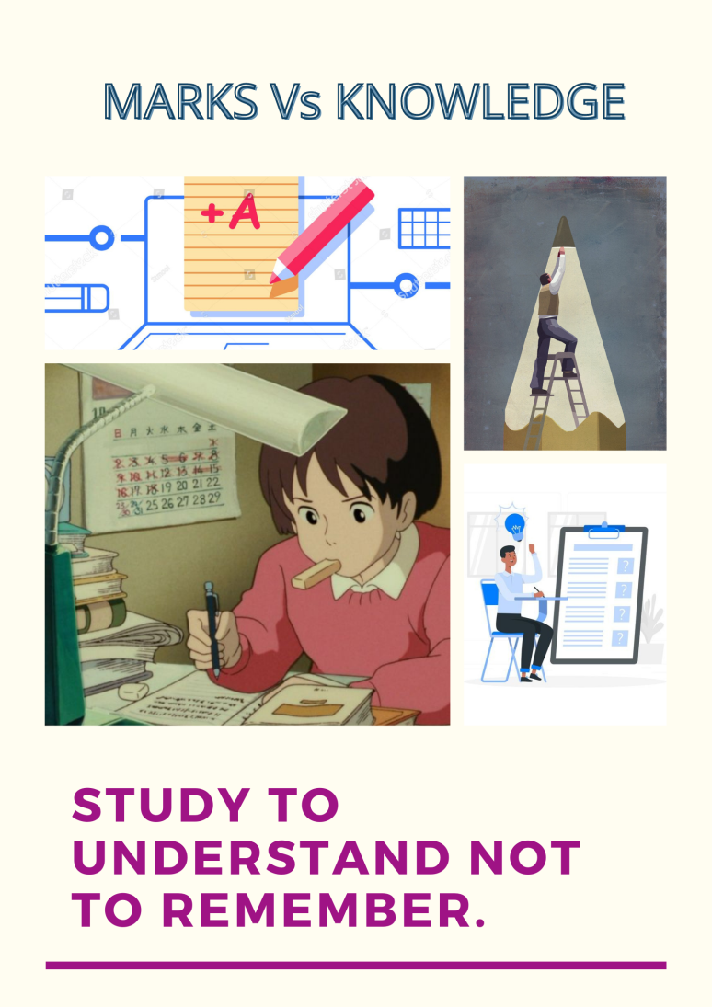
Nugget
Insight: Marks and Grades are being too important than the knowledge.
Evidence: I saw people memorizing the theory without understanding.
Movie title : MARKS Vs KNOWLEDGE
Poster: student mugging up for exam.

